Slide 2

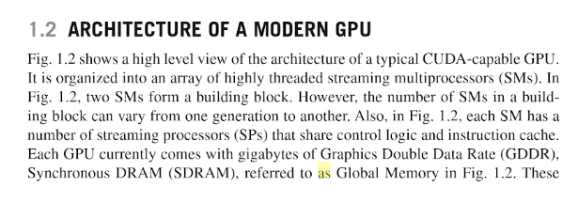

Slide 3
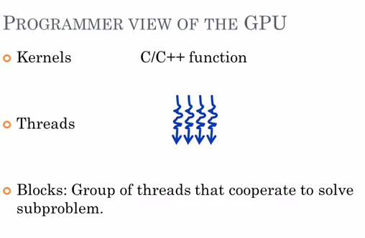

Slide 4
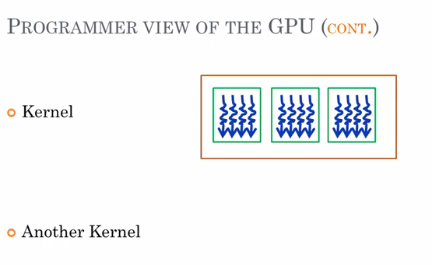

Slide 5
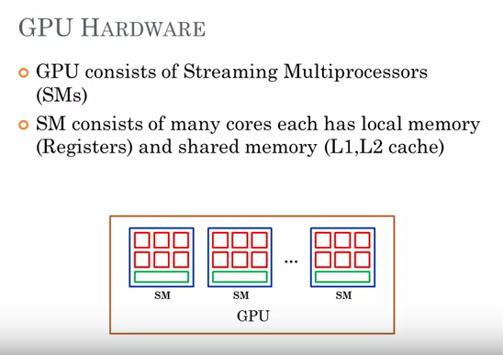

Slide 6
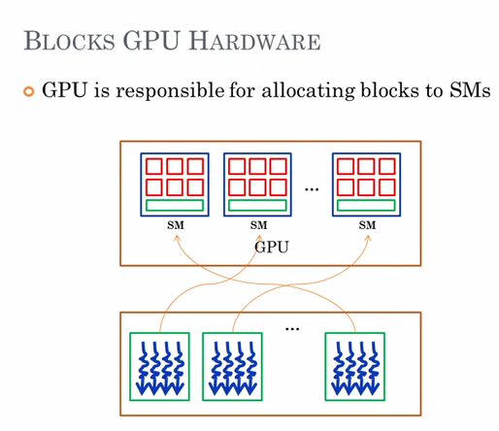

Slide 7
The streaming multiprocessors (SMs) are the part of the GPU that runs our CUDA kernels. Each SM contains the following. Thousands of registers that can be partitioned among threads of execution. Several caches: – Shared memory for fast data interchange between threads.
A GPU contains two or more Streaming Multiprocessors (SM) depending upon the compute capablity value.
Each SM consists of Streaming Processors (SP) which are actually responsible for the execution of instructions.
Each block is processed by SP in form of warps (32 threads).
Each block has access to a shared memory. A different block cannot access the data of some other block's shared memory.

Slide 8
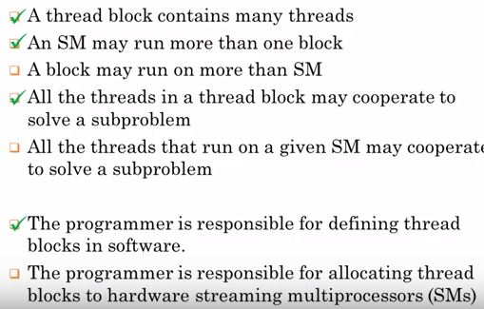

Slide 9
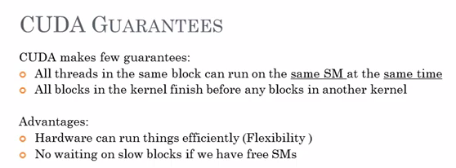

Slide 10
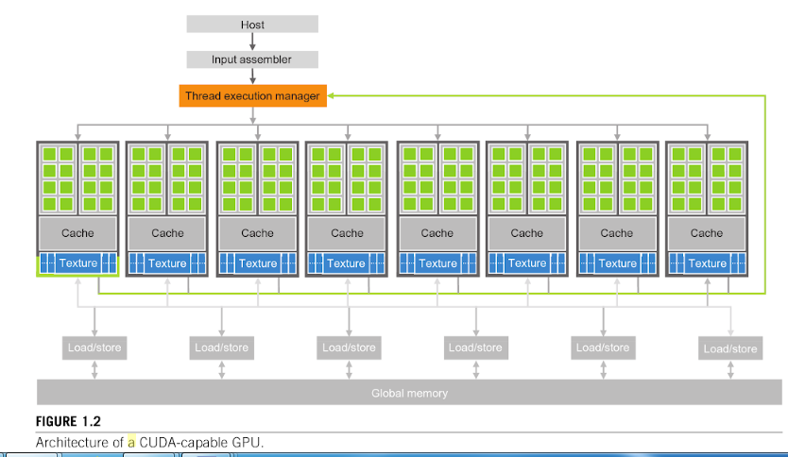

Slide 11
The streaming multiprocessors (SMs) are the part of the GPU that runs our CUDA kernels. Each SM contains the following.
Thousands of registers that can be partitioned among threads of execution
Several caches:
– Shared memory for fast data interchange between threads
– Constant cache for fast broadcast of reads from constant memory
– Texture cache to aggregate bandwidth from texture memory
– L1 cache to reduce latency to local or global memory

Slide 12
Constant memory resides in device memory, but it is backed by a different, read-only cache that is optimized to broadcast the results of read requests to threads that all reference the same memory location.

Slide 13
Stream: For data movement between kernels. All data are expressed in the form of streams.
Stream processors belong to a new class of architectures that are compute intensive, and achieve high performance by reducing dynamic control, and providing a large number of programmable functional units.
The main architectural components of a stream processor are shown in Fig. 2. Stream processors are specifically designed for the stream execution

Slide 14
Stream processors are specifically designed for the stream execution , in which applications have large amounts of explicit parallel computation, structured and predictable control, and memory accesses that can be performed at a coarse granularity.
Hence, their architecture also takes into account the concurrency and communication levels defined by the stream programming model in order to maintain high locality and parallelism levels.

Slide 15
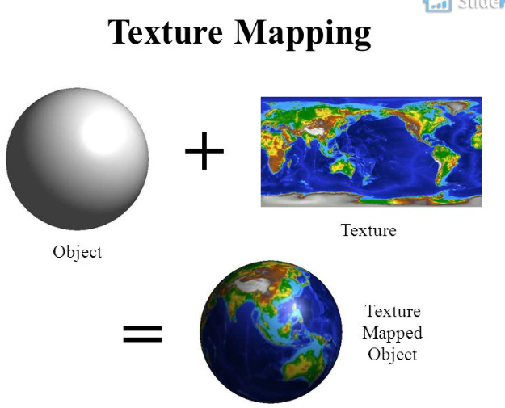
A texture mapping unit (TMU) is a component in modern graphics processing units (GPUs). Historically it was a separate physical processor. A TMU is able to rotate, resize, and distort a bitmap image (performing texture sampling), to be placed onto an arbitrary plane of a given 3D model as a texture.

Slide 16
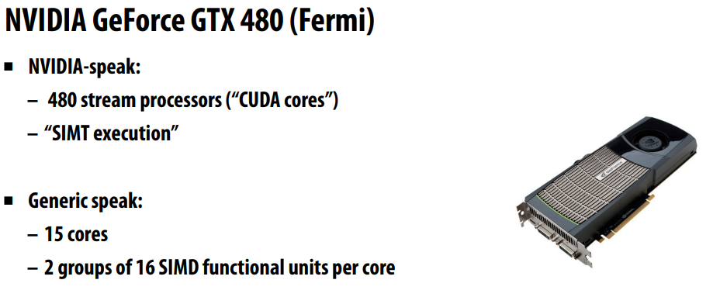

Slide 17
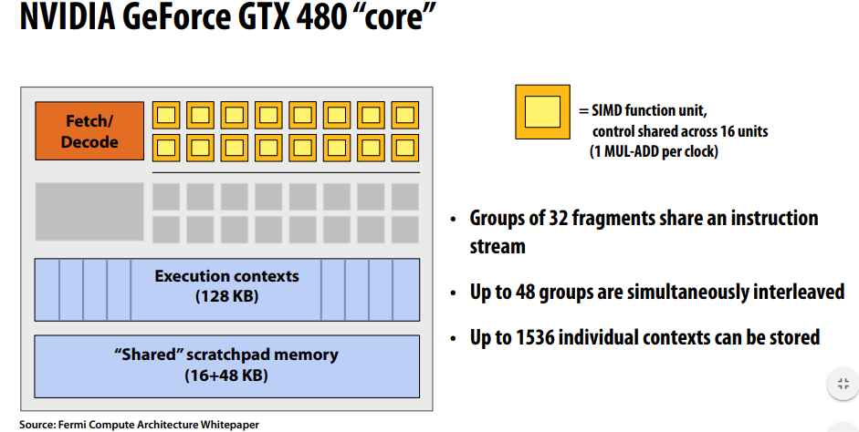

Slide 18
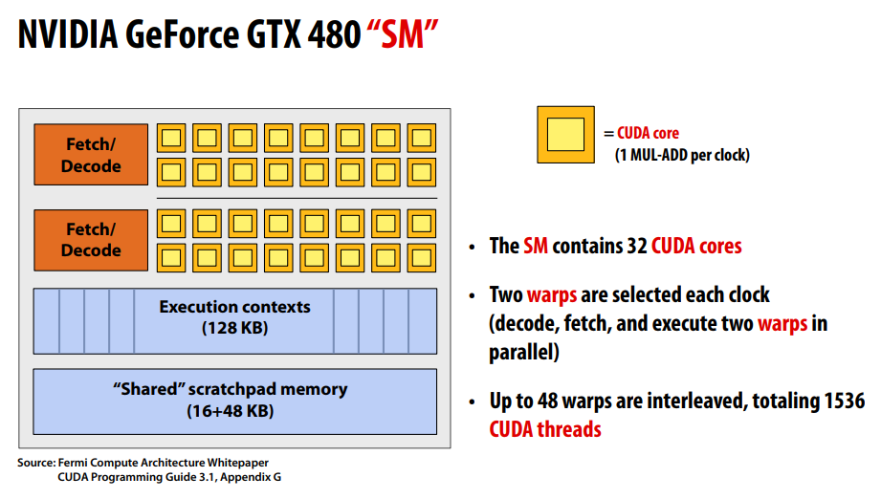

Slide 19
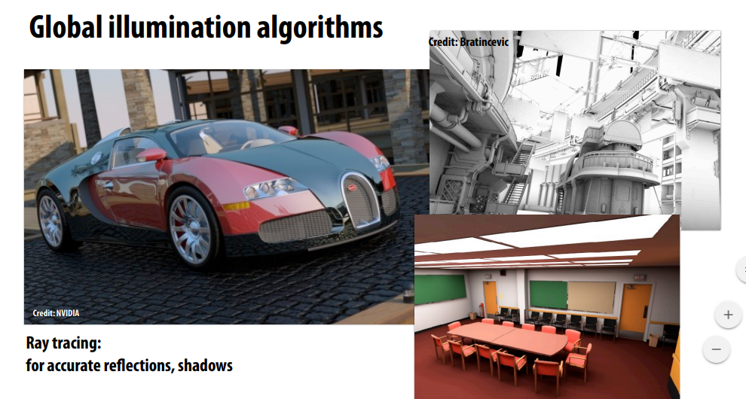

Slide 20
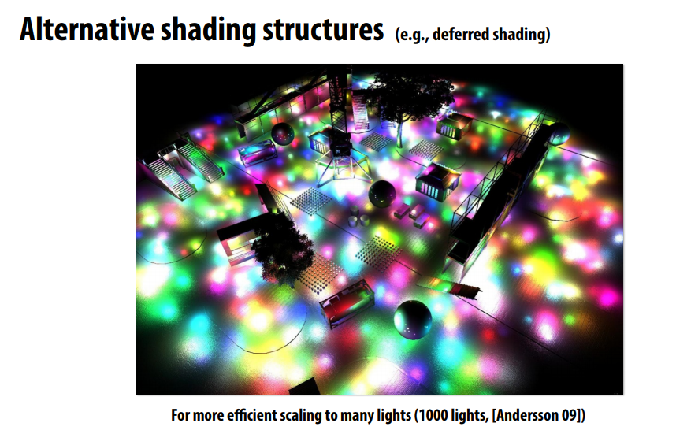

Slide 21
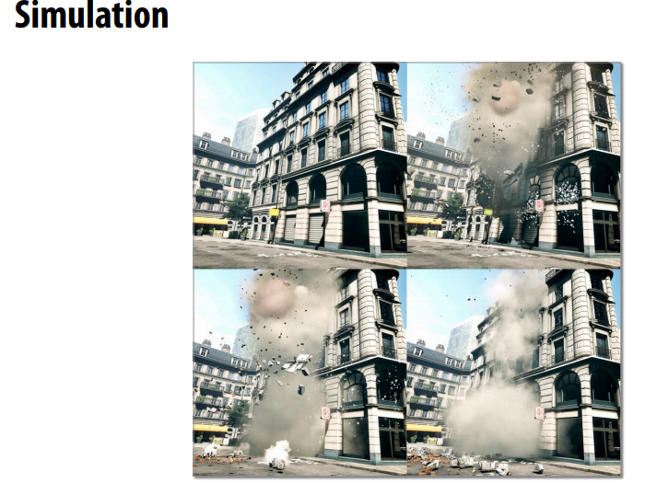

Slide 22
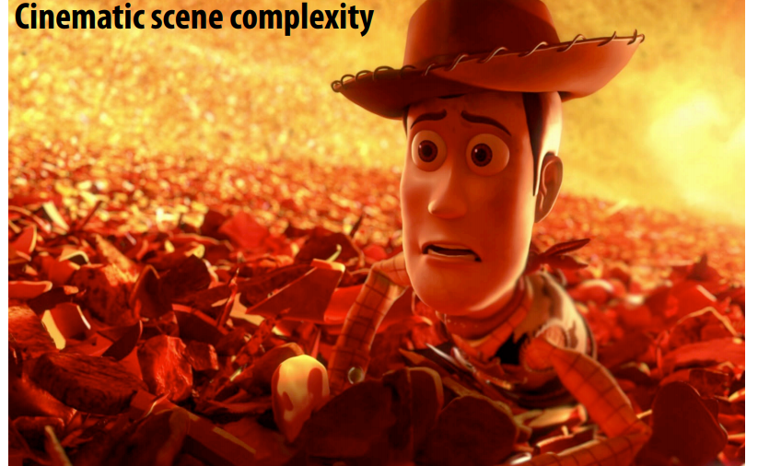

Slide 23


Slide 24
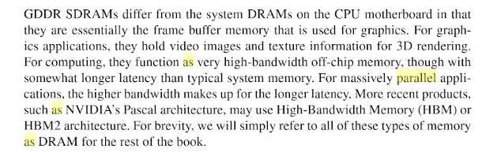

Slide 25
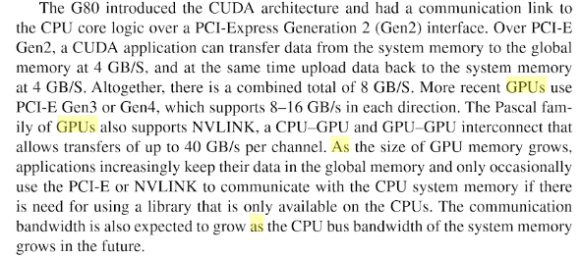

Slide 26
CPU/GPU : memory bandwidth CPU-GPU link, Pci-express bus x16, Gen2 : BP = 16∗2∗250MBytes/s = 8 GBytes/s CPU-local : DDR memory (f = 266MHz) BP= 266∗106 *4 (transferts/cycle) * 8 (bytes) = 8.5 GBytes/s GPU-local (carte GTX280) : 512-bit bus, DDR@f = 1100MHz, BP= 2∗1100∗106 (transferts/s) * 512/8 (bytes/transfert)= 140 GBytes/s

Slide 27
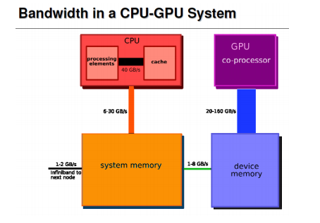

Slide 28
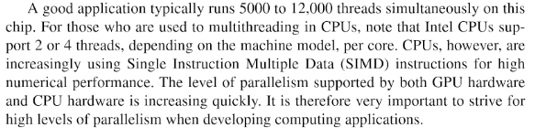

Slide 29
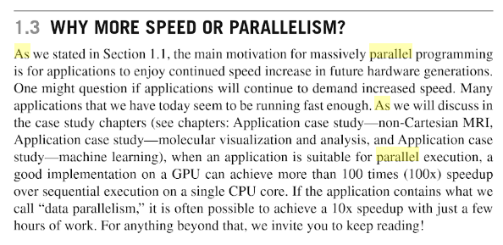

Slide 30
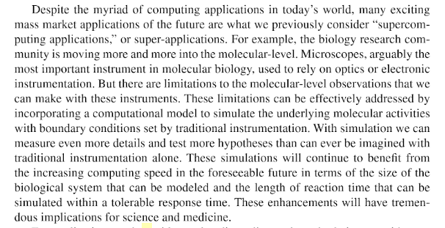

Slide 31
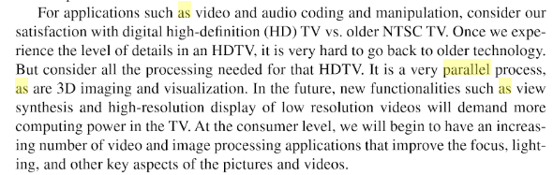

Slide 32
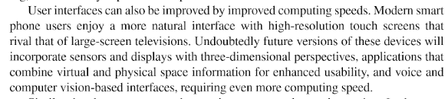

Slide 33
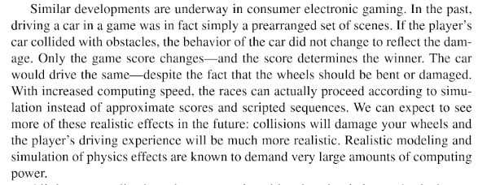

Slide 34
Driven by the billion-dollar market of game development with ever increasing performance demands, GPUs have evolved into a massively parallel compute engine. Because of the high performance demands the architecture of a GPU is drastically different from that of a CPU, transistors are used for computational units instead of caches and branch prediction and their architecture is optimized for high throughput instead of low latency [2]. Moreover, GPU performance doubles every six months [5] in contrast to the CPU performance which doubles every 18 months

Slide 35
Consequently GPUs offer order(s) of magnitude greater performance and are widely considered as the computational engine for the future. Since early 2002-2003 there has been a massive interest in utilizing GPUs for general purpose computing applications under the term General Purpose computing on GPU (GPGPU). This shift was primarily motivated by the evolution of the GPU from just a hardwired implementation for 3D graphics rendering, into a flexible and programmable computing engine.

